Slide 1
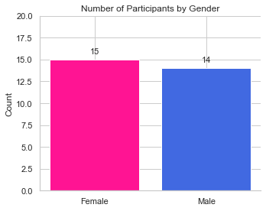
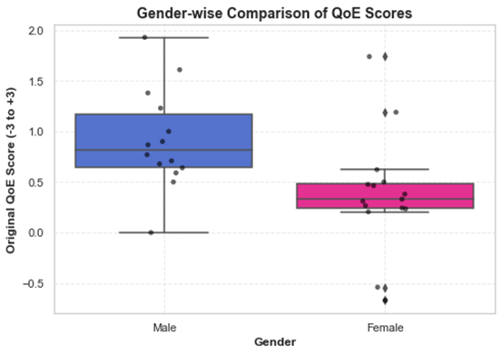
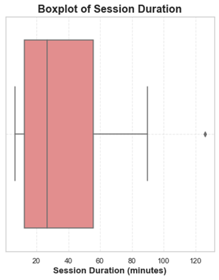
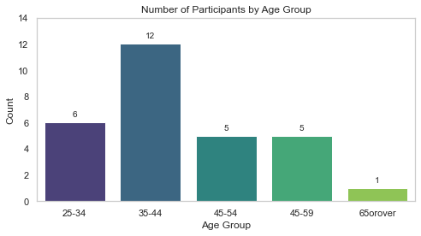
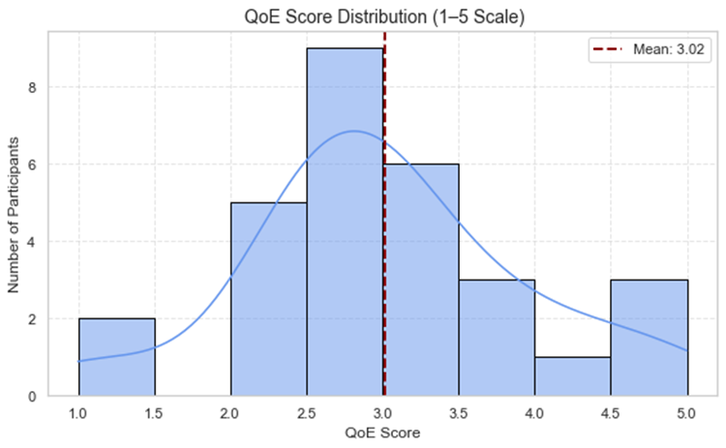
Results
Dataset | Entries | Columns | Description
Dataset 1-SUS-Q | 15 participants | 107 columns | Raw questionnaire + feedback data, including subjective QoE dimensions, slider ratings, text feedback, and emotional reactions.
Dataset 2 UEQ-S | 14 participants | 34 columns | Structured post-session survey with additional technical feedback and impression ratings.
A total of 29 participants, with 15 females and 14 males
Gender-wise QoE Score Comparison
P-value= 0.0112
T= 2.730
Age Group-wise Count
Overall Positive QoE Reported

Slide 2
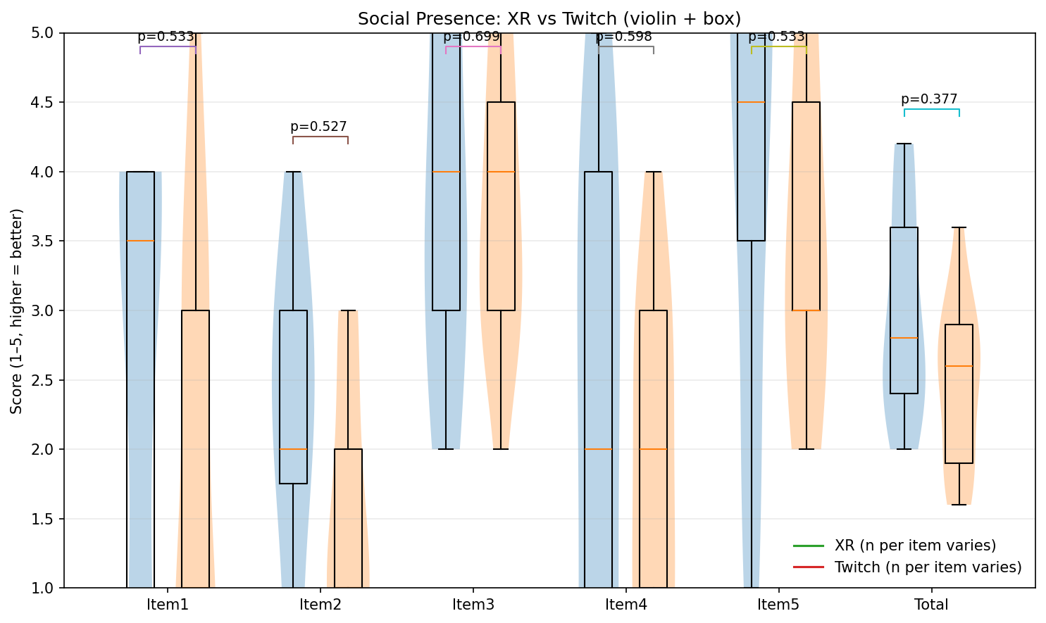

Slide 3
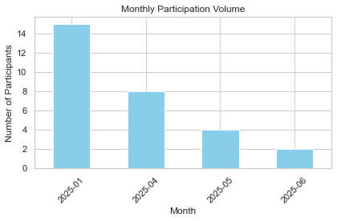
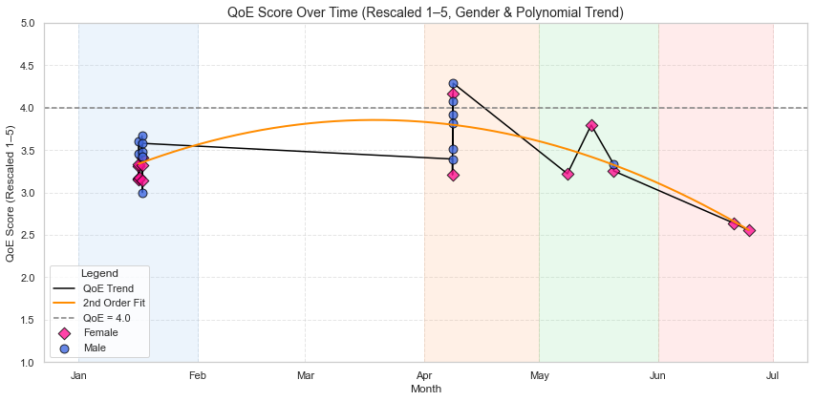
QoE Trends over Time
📈 QoE rises Jan → Apr Participants initially reported better experiences or improvements
📉 QoE falls after Apr Something possibly caused satisfaction to decline (e.g., technical issues?)
Notes:
👨‍🦱 Males clustered near high scores early
Male users may have been more satisfied in early sessions
👩 Females in later months ↓Female users may report slightly lower QoE, especially in later months

Slide 4
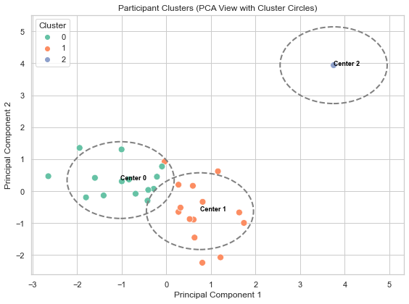
Cluster Analysis to determine patterns
Cluster 0: Mostly male, higher QoE, but wide variability in duration.
Cluster 1: All female, lower QoE, more consistent session lengths.
Cluster 2: An outlier
Insight: Gender is a dominant factor in both QoE and clustering structure
Cluster | Median QoE | Std QoE | Count | Median Duration (mins) | Std Duration | Count | Female | Male
0 | 0.3200 | 0.4526 | 14 | 29.23 | 32.52 | 14 | 14 | 0
1 | 0.8835 | 0.5284 | 14 | 26.73 | 27.15 | 14 | 1 | 13
2 | 0.5900 | — | 1 | 1305.50 | — | 1 | 0 | 1

Slide 5
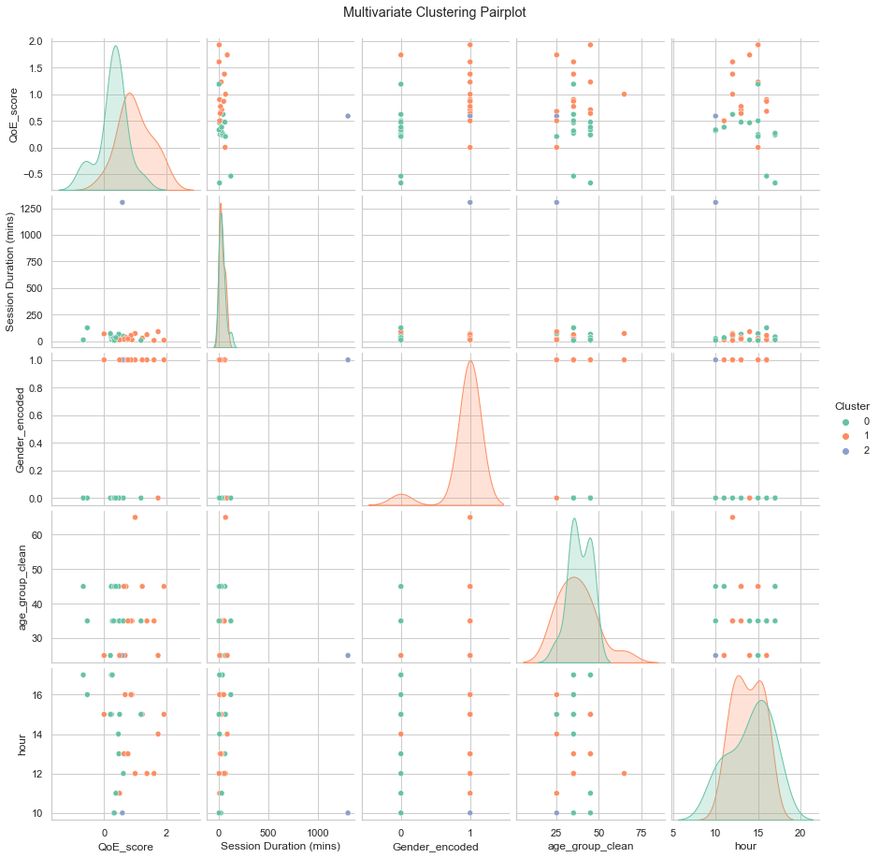
Pair plot Analysis for uncovering hidden patterns
🔴 Cluster 1 (Orange)Dominated by Female participants: separated on Gender.
Lower QoE scores: density is skewed left (around ~0.3–0.6).
Relatively short sessions with few outliers
Tightly grouped in mid-age range (30–45)
Appears around midday hours
This may represent female users who had shorter sessions and rated the experience lower.
🟢 Cluster 0 (Green)
Primarily Male
Higher QoE scores: clear density peak >1
Broader age range, more variation in session duration
Sessions happen across more time slots (hours)
Likely represents males who had a better experience, with a broader time spread.
🔵 Cluster 2 (Blue)Tiny, possibly an outlier cluster
Only a few points — very extreme values, especially in Session Duration
Scattered across other dimensions
This might be an artifact cluster capturing outliers, like the one with >1300 minutes of duration.

Slide 6
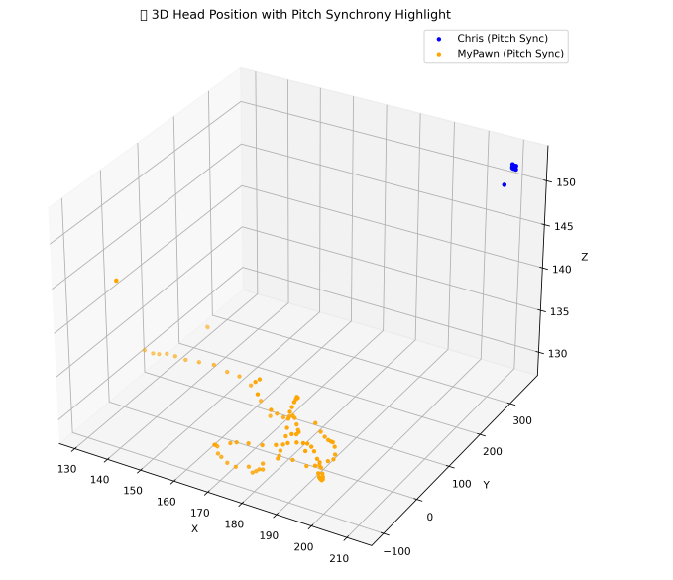
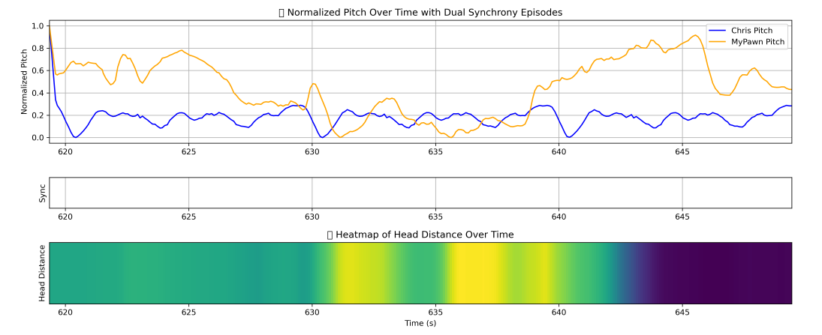

Slide 7
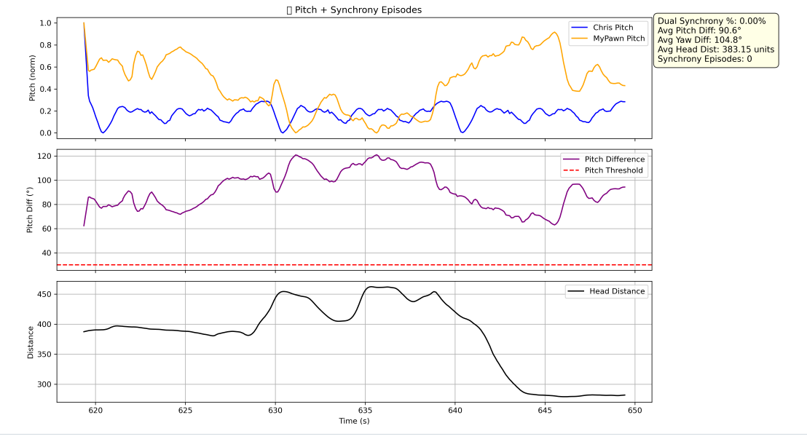

Slide 8
